Slide 1

Chronic Disease Management Dashboard minor project 1 (18b19ci591) mentor : dr. Gaurav Saxena project team: Sakshi Dubey(221b493) Anushka purohit(221b489) Samarth gupta(221b477)

Slide 2
Discussion points
Overview
Why we need it?
Role of Imaging (CT Scans)
Dashboard Capabilities
Block Diagram
Technologies used
Project differentiator
Outcomes and Exceptions
References

Slide 3

Overview
Problem Statement: COVID-19 has increased chronic respiratory issues, but current tools lack real-time insights and advanced analytics for effective management. Healthcare providers need better tools to track and manage post-COVID lung health.
This project develops a Chronic Disease Management Dashboard that integrates CT scans, AI analytics, and predictive modeling to monitor post-COVID lung health. The dashboard provides real-time insights, enabling data-driven decisions for better long-term management of chronic respiratory diseases.

Slide 4
Why we need it?
Need for Efficient COVID-19 Disease Monitoring.
Support for healthcare providers
Automation and AI Integration
Pandemic Preparedness and Response
Data-Driven Insights for Public Health
Patient Empowerment

Slide 5
Role of imaging(ct scans)
Imaging plays a critical role in your chronic disease management dashboard, especially when focused on COVID-19 lungs CT scans.
Diagnosis and Initial Assessment
Monitoring Disease Progression
Long-Term Management of Chronic Lung Conditions
Quantifying Lung Damage
Artificial Intelligence and Predictive Modeling
Risk Stratification

Slide 6
Dashboard capabilities
For a chronic disease management dashboard focused on COVID-19 lungs CT scans, here are the key capabilities the dashboard should offer:
Patient Data Integration
Imaging Data Visualization
Disease Progression Tracking
Personalized Treatment Monitoring
Risk Stratification
User-Friendly Interface

Slide 7
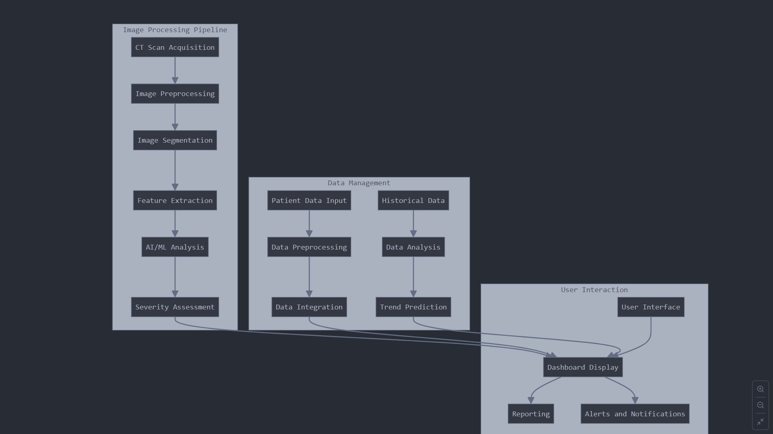

Slide 8
Project differentiator
Existing Market Solutions: Most COVID-19 imaging tools focus on acute phase detection (e.g., identifying pneumonia, ground-glass opacities) or short-term disease progression.
Our Project's Difference: Our project emphasizes long-term monitoring and management of chronic respiratory conditions caused by COVID-19 (e.g., pulmonary fibrosis, chronic inflammation)

Slide 9
TECHNOLOGies used
Languages/tools:
Html
Css
OpenCv
Power Bi
python
Jupyter Notebook

Slide 10
Work done till now
We explored and selected key tools and libraries for the project, including Python libraries such as NumPy, Pandas,matplotlib.
We studied and gathered information on image processing and machine learning from various books and online resources. We learned how to integrate this knowledge into the project to develop AI-driven analytics and predictive modeling for real-time lung health monitoring.
We are working on pre-processing of our image dataset, including tasks such as loading and resizing CT scan images to standardize dimensions and ensure consistency before further analysis.

Slide 11

Outcomes and Exceptions
Early Detection & Prevention
Reduced Hospitalizations & Readmissions
Data-Driven Decision Making
Data Quality and Accuracy
Emphasizes long-term monitoring of chronic diseases
Integrating Dashboards into Clinical Workflows

Slide 12
References
Sanjay sharma, *digital image processing*, 2nd ed. New delhi, India :S.K. Kataria & sons, 2010.
R. B. Patel, *Machine Learning for Beginners: A Comprehensive Guide to Learn and Understand the Fundamentals of Machine Learning*. Independently Published, 2020.
A. Géron, *Hands-On Machine Learning with Scikit-Learn, Keras, and TensorFlow*. 3rd ed. Sebastopol, CA, USA: O'Reilly Media, 2022.

Slide 13
Thank you

